Slide 1
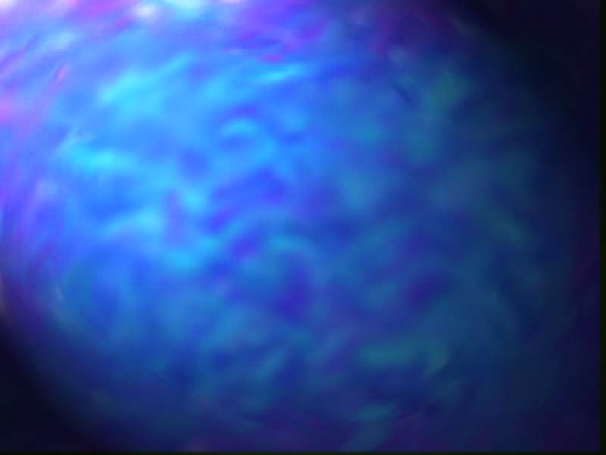
Biochemical Tests
By Cheryl Kent

Slide 2
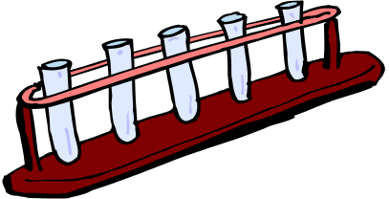
Biochemical Tests
Biochemical tests identify the main biologically important chemical compounds.
For each test take a small amount of the substance to test, shake it in water in a test tube.(The substance may need grinding with a pestle and mortar, to break up the cells and release the cell contents.)
Many of these compounds are insoluble, but the tests work just as well in a fine suspension.

Slide 3
Benedict’s Test For Reducing Sugars
All monosaccharide’s and most disaccharide's will reduce copper (II) sulphate, producing a precipitate of copper (I) oxide on heating, so they are called reducing sugars.
Benedict’s reagent is an aqueous solution of copper (II) sulphate, sodium carbonate and sodium citrate.
Grind up sample
To approx. 2cm3 of test solution add equal quantity of Benedict’s reagent.
Shake, and heat for a few minutes at 95°C in a water bath
A precipitate indicates reducing sugars
Original Pale Blue = no reducing sugar
Brown/Red = reducing sugar

Slide 4
Benedict’s Test For Non-Reducing Sugars
Non-Reducing sugars do not reduce copper sulphate. However, if it is first hydrolysed to its constituent monosaccharides, it will then give a positive Benedict’s Test.
First test a sample for reducing sugars, to see if there are any present before hydrolysis.
Then using a separate sample,
⇒ Boil the test solution with dilute hydrochloric acid for a few minutes to hydrolyse the glycosidic bond.
⇒ Neutralise, by adding small amounts of solid sodium hydrogen carbonate until it stops fizzing.
⇒ Perform the Benedict’s test
⇒ A positive result indicates the presence of simple non-reducing sugar.

Slide 5
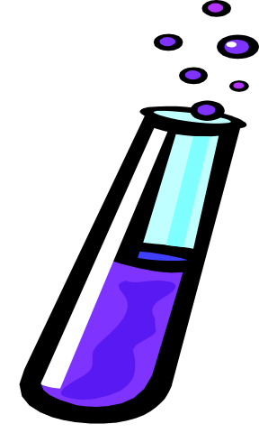
Iodine Test For Starch
⇒ To approximately 2cm of the test solution add 2 drops of iodine/potassium iodide solution.
⇒ A blue/black colour indicates the presence of starch.
Starch is only slightly soluble in water, but the test works well in a suspension or as a solid.

Slide 6
Emulsion Test For Lipids
Lipids do not dissolve in water, but do dissolve in ethanol. This characteristic is used in the emulsion test.
⇒ Grind up sample
⇒ Shake some test sample with about 4cm3 of ethanol.
⇒ Decant the liquid into a test tube of water leaving any un-dissolved substances between.
If there are lipids dissolved in the ethanol, they will precipitate in the water, forming a cloudy white emulsion.

Slide 7


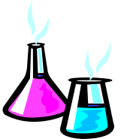
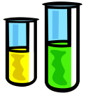
Biuret Test For Protein
⇒ To about 2cm3 of test solution add an equal volume of biuret solution, down the side of the test tube.
⇒ A blue ring forms at the surface of the solution, which disappears on shaking, and the solution turns lilac-purple, indicating protein.
The colour change is due to a complex between nitrogen atoms in a peptide chain and copper (II) ions, so this is really a test for peptide bonds.

